Slide 1
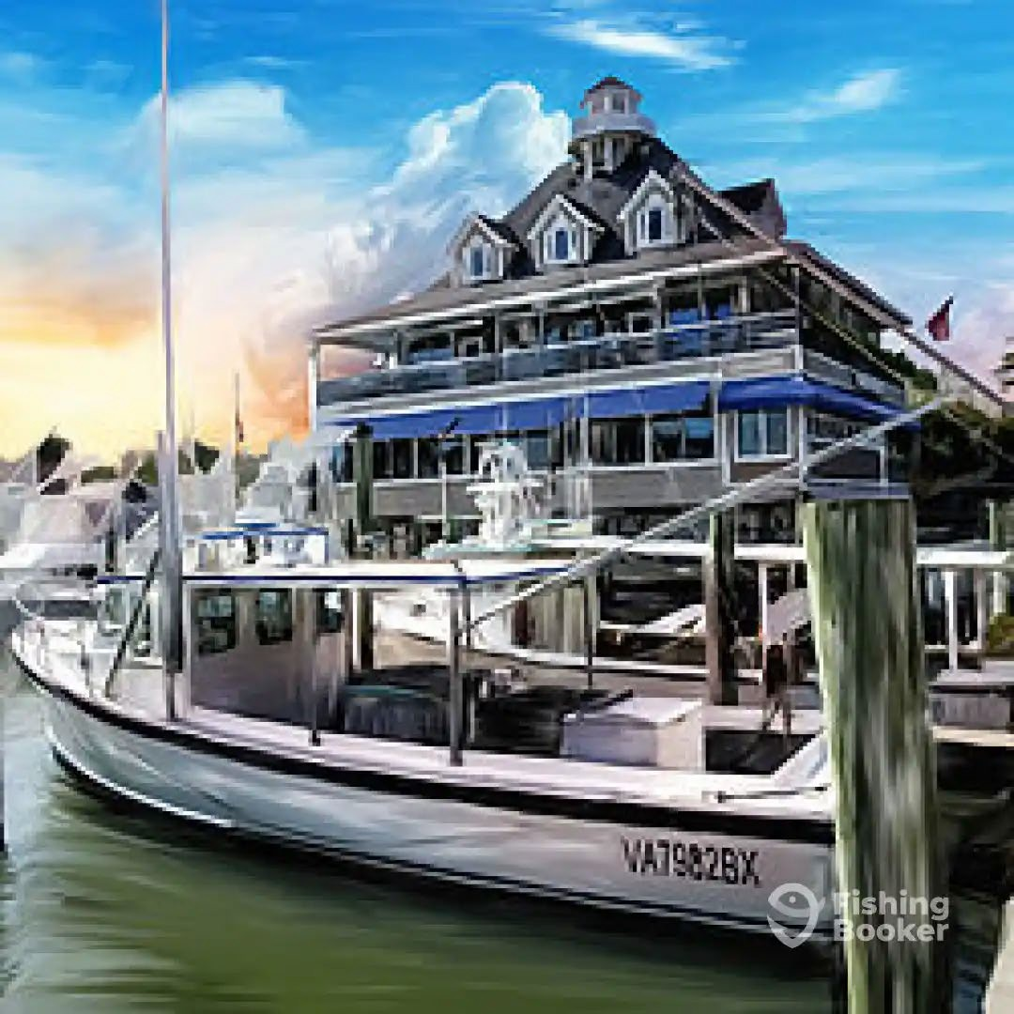
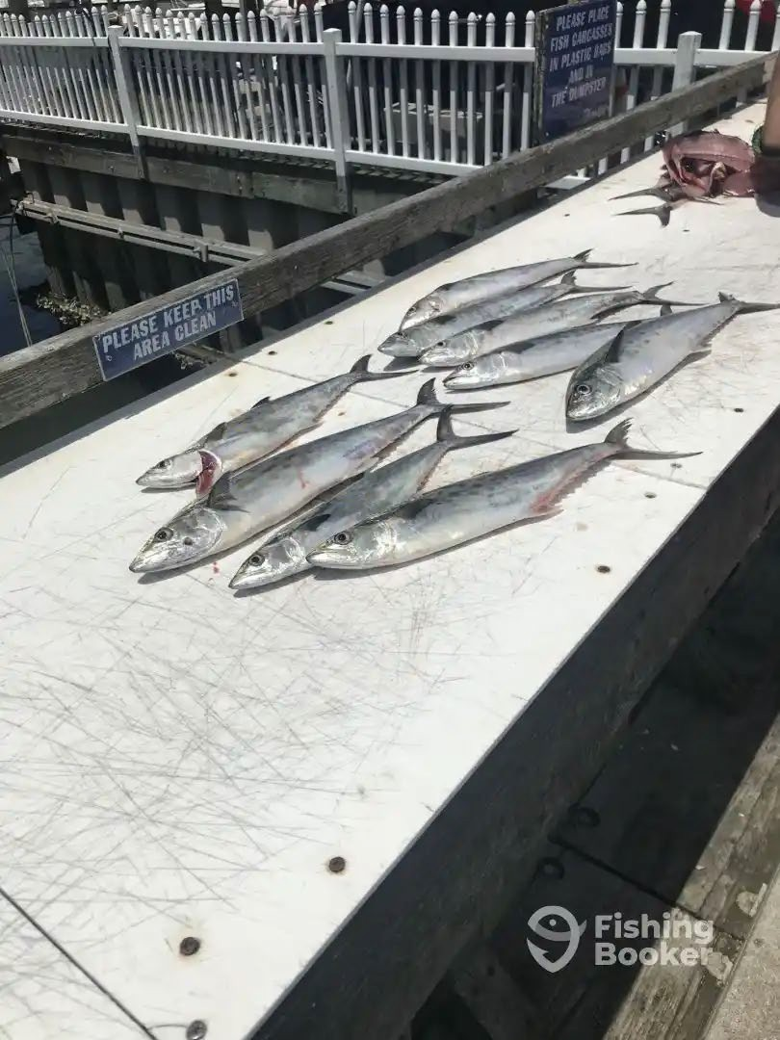
COAST GUARD DISTRICT 5
FY24 FV District Coordinator Report
LT Gary George

Slide 2
FY 24 CFV Boarding Stats
At Sea Boardings: 215
Violations Issued: 92

Slide 3
FY 24 CFV Dockside Stats
Dockside Exams: 273
Deficiencies Issued: 105
CFV Decals Issued: 234

Slide 4
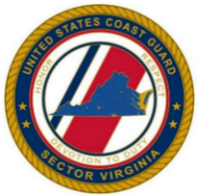
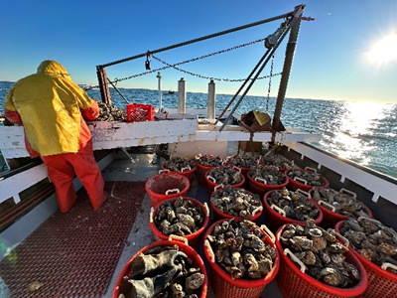
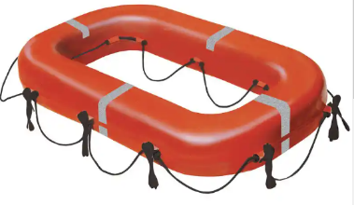
Coast Guard Sector Virginia OPERATION AWE SHUCKS 2023/2024
Overview:
Commercial fishing is one of the most dangerous occupations. This operation focused on mitigating loss of life through greater awareness of safety gear requirements.
Boardings focused on oyster vessels in the open season harvest areas to check safety equipment and stress the benefits of the voluntary dockside exam.
Conducted this operation from 01 Dec 2023 to 31 Jan 2024.
Bravo Zulu! to CGC SAILFISH for coordinating joint operations with Station Milford Haven and Station Crisfield in the Sector Virginia Captain of the Port Zone.
Local fisherman with bushels of oysters
Commercial Fishing Vessel Training:
In preparation for the cold-water season and Operation AWE SHUCKS, the CFVS Examiners hosted just in-time training in support of local field-units.
Commercial Fishing Vessel Safety Exams:
53 CFVs were examined (29 scheduled & 24 unscheduled)
Unscheduled activities were a direct result of interactions with boarding teams or indirect interactions, i.e. they witnessed other vessels being boarded/terminated in their area.
09 were directly driven by voyage terminations and subsequent COTP orders.
15 vessels contacted UVB and received their initial CFV safety decal.
Community outreach:
Proactive messaging: Issued press release in December on enforcement actions and the importance of having correct lifesaving equipment onboard.
Buoyant apparatus
SAILFISH cutter boat and Station Crisfield RB-M
*All vessels terminated for failure to produce survival craft or valid survival craft exemption.
 | CFVS Boardings | Violations | Terminations
CGC POMPANO: | 14 | 15 | 3
CGC SAILFISH: | 12 | 6 | 4
CGC SEAHAWK: | 6 | 4 | 1
Sta Crisfield: | 2 | 6 | 1
Sta Milford Haven: | 17 | 4 | 2
Total: | 51 | 35 | 11

Slide 5
Fifth District CFV Public Outreach
District sponsored fishing industry expos, forums, meetings:
Jan 2024 - Maryland Waterman’s Expo (Ocean City MD)
Feb & Mar 2024 - Atlantic City New Jersey Boat Show

Slide 6
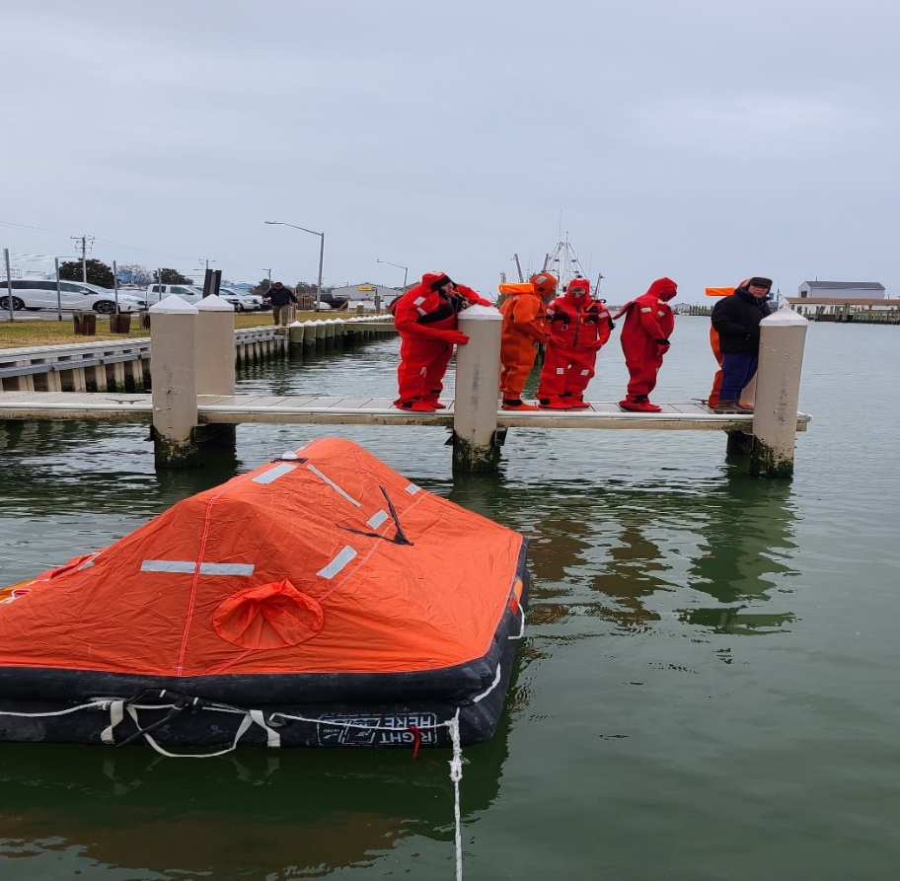
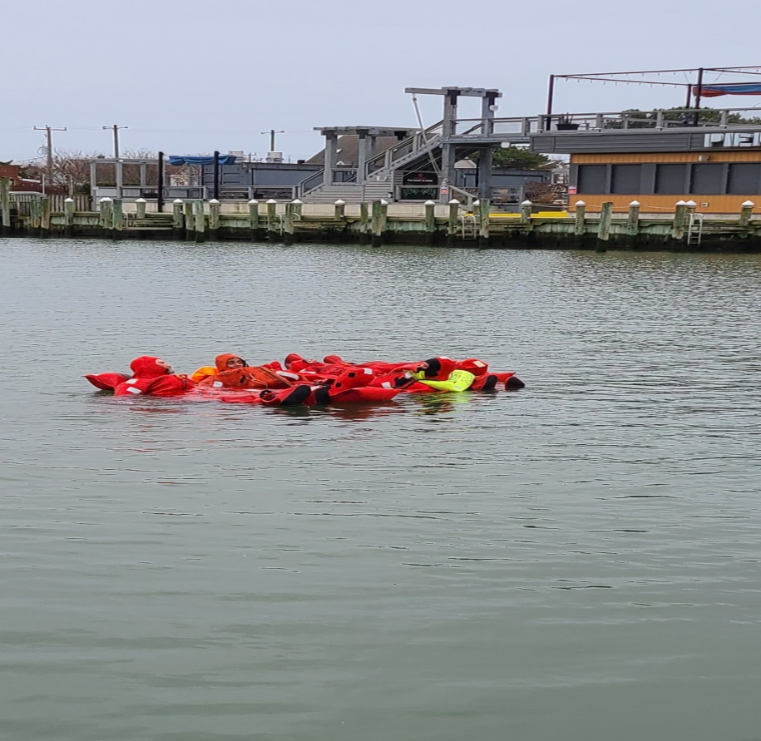
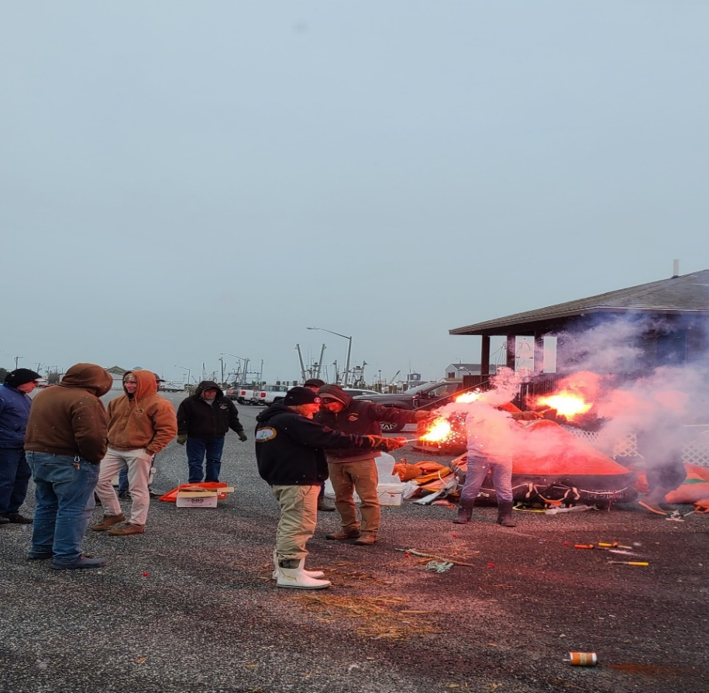
January 12-14: Fifth District Commercial Fishing Vessel Examiners attended a 3-day Expo in Ocean City MD to conduct public outreach and education for industry professionals and the maritime public. Attendance generated 24 new requests for Dockside Exams. Following the Expo, Sector Virginia CFV Examiners supported AMSEA training with the use of their Damage Control Trailer. In total, 11 “students” attended the training on Damage Control, Firefighting , Visual Distress Signals, dewatering via a CG P-6 pump, and classroom training. Students became familiar with abandon ship procedures and life raft deployment/ inflation procedures. Air and water temperatures were in the 40’s, providing a realistic and chilling reminder on the importance of safety training.
2024 Ocean City Waterman’s Expo

Slide 7
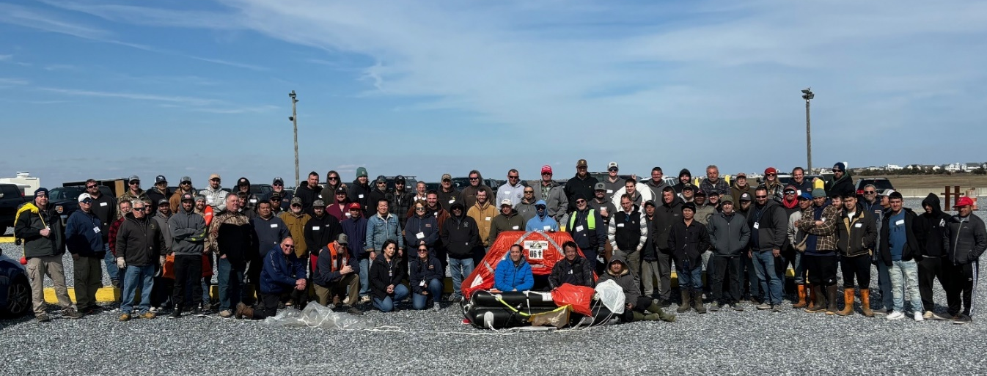
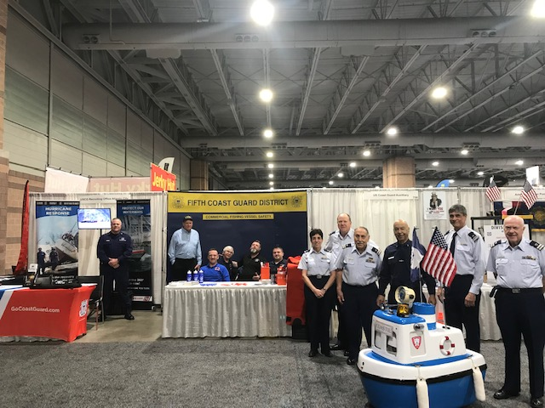
2024 Atlantic City Boat Show
February 28th – March 3rd: Examiners out of the Sector Delaware Bay Office attended this five-day event to crew a Safety and Informational booth and conduct congressionally mandated outreach industry professionals and members of the general maritime public. Participation resulted in numerous new sign-ups for dockside exams, uninspected passenger vessel (6 pax) exams, and recreational boating safety checks. Additionally, the team identified an owner/operator of a Small Passenger Vessel (T) in the construction phase. This year’s show attracted more than 37,000 attendees and the Commercial Vishing Vessel Safety booth was collocated with local CG Auxiliarists and Recruiters.
Immediately following the Boat Show, examiners from Sector Delaware Bay provided 2 days of Drill Conductor training in Cape May with Fishing Partnership Support Services. In total there were over 110 Commercial Fishermen in attendance. Training included: Damage Control (flooding), Fire Fighting, Donning of Immersion Suits, Deploying a Life Raft, Emergency Radio Procedures, Use of Flares, and Classroom Training.

Slide 8
Fifth District Planning Direction
Use risk-based decision making when using limited Coast Guard resources to target commercial fishing vessels.
Maintain consistent engagement with organic intelligence staff.
Expand existing outreach to the commercial fishing vessel community.
Seek to enhance station and cutter Coast Guard Boarding Officer competency and effectiveness through CFVS examiner led training.
Increase participation and optimize use of Coast Guard Active Duty, Reserves, and Auxiliary to meet CFVS performance goals.

